Slide 1

Relations, Functions, and Matrices
Mathematical Structures for Computer Science
Chapter 5
Copyright © 2014 W.H. Freeman & Co. MSCS Slides Section 5.7

Slide 2
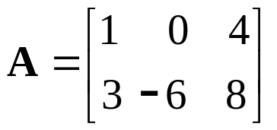
Matrix
Data about many kinds of problems can often be represented using a rectangular arrangement of values; such an arrangement is called a matrix.
A is a matrix with two rows and three columns.
The dimensions of the matrix are the number of rows and columns; here A is a 2 × 3 matrix.
Elements of a matrix A are denoted by a_{ij}, where i is the row number of the element in the matrix and j is the column number.
In the example matrix A, a₂₃ = 8 because 8 is the element in row 2, column 3, of A.
Section 5.7
Matrices

Slide 3
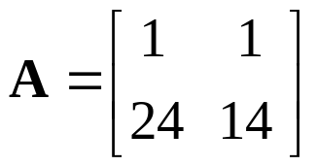
Example: Matrix
The constraints of many problems are represented by the system of linear equations, e.g.:
x + y = 70
24x + 14y = 1180
The solution is x = 20, y = 50 (you can easily check that this is a solution).
The matrix A is the matrix of coefficients for this system of linear equations.
Section 5.7
Matrices

Slide 4
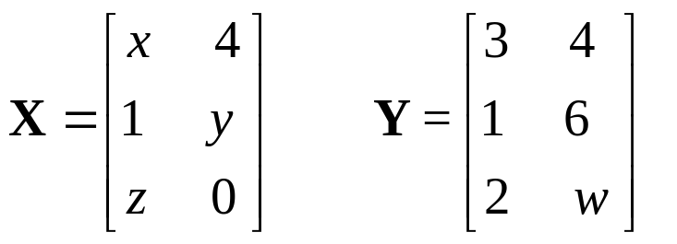
Matrix
If X = Y, then x = 3, y = 6, z = 2, and w = 0.
We will often be interested in square matrices, in which the number of rows equals the number of columns.
If A is an n × n square matrix, then the elements a₁₁, a₂₂, ... , a_{nn} form the main diagonal of the matrix.
If the corresponding elements match when we think of folding the matrix along the main diagonal, then the matrix is symmetric about the main diagonal.
In a symmetric matrix, a_{ij} = a_{ji}.
Section 5.7
Matrices

Slide 5
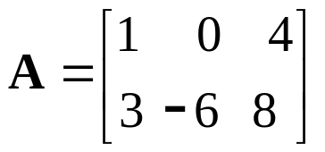
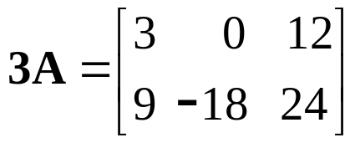
Matrix Operations
Scalar multiplication calls for multiplying each entry of a matrix by a fixed single number called a scalar. The result is a matrix with the same dimensions as the original matrix.
The result of multiplying matrix A:
by the scalar r = 3 is:
Section 5.7
Matrices

Slide 6
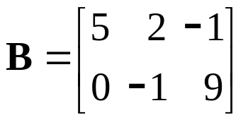
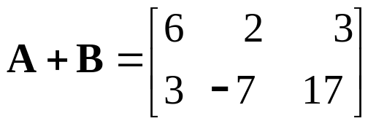
Matrix Operations
Addition of two matrices A and B is defined only when A and B have the same dimensions; then it is simply a matter of adding the corresponding elements.
Formally, if A and B are both n × m matrices, then C = A + B is an n × m matrix with entries c_{ij} = a_{ij} + b_{ij}:
Section 5.7
Matrices

Slide 7
Matrix Operations
Subtraction of matrices is defined by
A − B = A + (− l)B
In a zero matrix, all entries are 0.
  If we add an n × m zero matrix, denoted by 0, to any n × m matrix A, the result is matrix A.
  We can symbolize this by the matrix equation:
0 + A = A
If A and B are n × m matrices and r and s are scalars, the following matrix equations are true:
A + B = B + A
(A + B) + C = A + (B + C)
r(A + B) = rA + rB
(r + s)A = rA + sA
r(sA) = (rs)A
rA = Ar
Section 5.7
Matrices

Slide 8
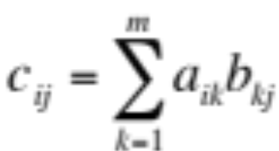
Matrix Operations
Matrix multiplication (A times B) is denoted as A ⋅ B.
Condition required for matrix multiplication: the number of columns in A must equal the number of rows in B. Thus we can compute A ⋅ B if A is an
n × m matrix and B is an m × p matrix. The result is an n × p matrix.
An entry in row i, column j of A ⋅ B is obtained by multiplying elements in row i of A by the corresponding elements in column j of B and adding the results. Formally, A ⋅ B = C, where
Section 5.7
Matrices

Slide 9
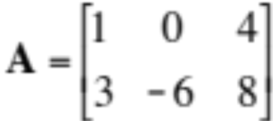
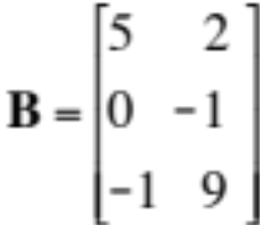
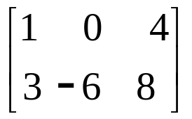
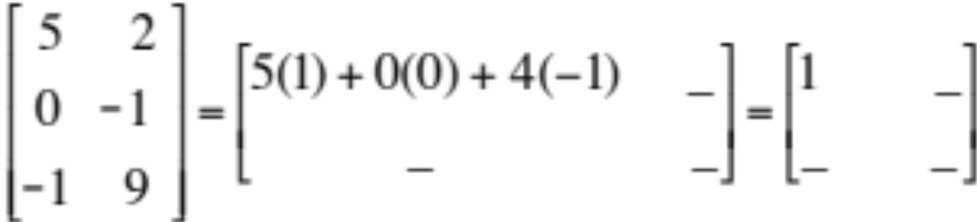
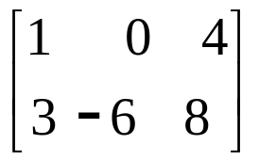
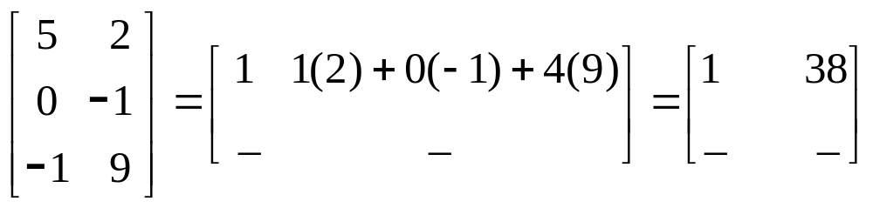
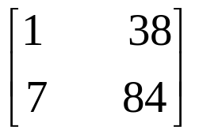
Example: Matrix Multiplication
To find A ⋅ B = C for the following matrices:
Similarly, doing the same for the other row, C is:
Section 5.7
Matrices

Slide 10
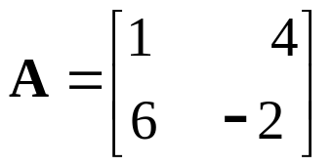
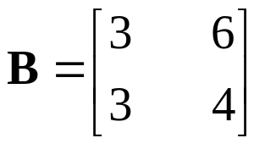
Exercise: Matrix Multiplication
Compute A ⋅ B and B ⋅ A for the following matrices:
Note that even if A and B have dimensions so that both A ⋅ B and B ⋅ A are defined, A ⋅ B need not equal B ⋅ A.
Example Calculations:
C = A ⋅ B
C₁₁ = 1 x 3 + 4 x 3 = 15
C₁₂ = 1 x 6 + 4 x 4 = 22
C₂₁ = 6 x 3 + (-2) x 3 = 12
C₂₂ = 6 x 6 + (-2) x 4 = 28
22
12 28
39 0
27 4
C =
=
C’ = B ⋅ A =
Section 5.7
Matrices

Slide 11
Matrix Multiplication
Where A, B, and C are matrices of appropriate dimensions and r and s are scalars, the following matrix equations are true (the notation A (B ⋅ C) is shorthand for A ⋅ (B ⋅ C)):
A (B ⋅ C) = (A ⋅ B) C
A (B + C) = A ⋅ B + A ⋅ C
(A + B) C = A ⋅ C + B ⋅ C
rA ⋅ sB = (rs)(A ⋅ B)
The n × n matrix with 1s along the main diagonal and 0s elsewhere is called the identity matrix, denoted by I. If we multiply I times any n × n matrix A, we get A as the result. The equation is:
I ⋅ A = A ⋅ I = A
Section 5.7
Matrices

Slide 12
Matrix Multiplication Algorithm
ALGORITHM MatrixMultiplication
//computes n × p matrix A ⋅ B for n × m matrix A, m × p matrix B
//stores result in C
for i = 1 to n do
for j = 1 to p do
C[i, j] = 0
for k =1 to m do
C[i, j] = C[i, j] + A[i, k] * B[k, j]
end for
end for
end for
write out product matrix C
If A and B are both n × n matrices, then there are Θ(n³) multiplications and Θ(n³) additions required. Overall complexity is Θ(n³)
Section 5.7
Matrices

Slide 13
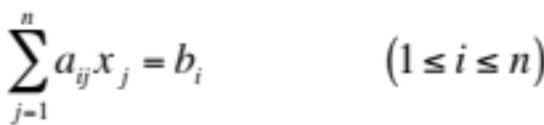
Gaussian Elimination- Linear Equations
An equation of the form ax+by+c=0 or equivalently ax+by=-c is called a linear equation in x and y variables.
ax+by+cz=d is a linear equation in three variables, x, y, and z.
Thus, a linear equation in n variables is
a₁x₁+a₂x₂+ … +a_{n}x_{n} = b
A solution of such an equation consists of real numbers c₁, c₂, c₃, … , c_{n}.
  If you need to work with more than one linear equation, a system of linear equations must be solved simultaneously.
a₁₁x₁+a₁₂x₂+ … +a_{1n}x_{n} = b₁
a₂₁x₁+a₂₂x₂+ … +a_{2n}x_{n} = b₂
. .
. .
a_{n1}x₁+a_{n2}x₂+ … +a_{nn}x_{n} = b_{n}
Section 5.7
Matrices

Slide 14
Gaussian Elimination
Gaussian elimination is a process that solves such a system of linear equations
The basic strategy is to successively solve one of the equations of the set for one of the unknowns and to eliminate that variable from the remaining equations by substitution.
To do this, one can
  Switch any two equations
  Multiply one equation by a non-zero scalar
  Add a scalar multiple of one row to another row.
Section 5.7
Matrices

Slide 15
Gaussian Elimination Example
For the system of equations
x + y = 70 Eq#1
24x + 14y =1180 Eq#2
Multiply the first equation by -24 and add it to the second equation. The result is the system
x + y = 70 Eq#1
0x + -10y = -500 Eq#3
From Eq#3 we have, y = 50.
Back substituting this in the first equation,
x = 70 - 50 =20
Section 5.7
Matrices

Slide 16
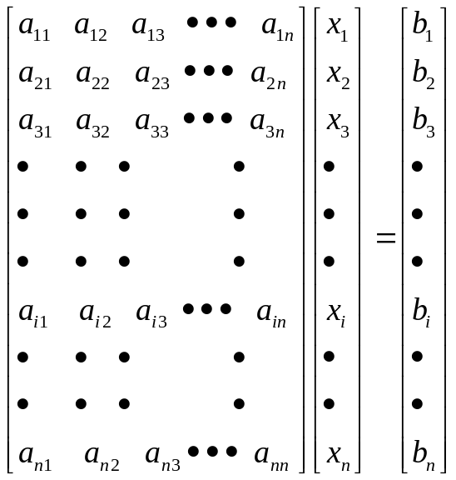
Gaussian Elimination
Using the matrix of coefficients, a system of n equations in n unknowns looks like this.
As in the case of the solution of two equations, the technique for n equations consists of two phases:
  Forward elimination of unknowns
    Results in a system in upper triangular form, where everything in the matrix of coefficients below the main diagonal is 0s.
  Back substitution
Section 5.7
Matrices

Slide 17
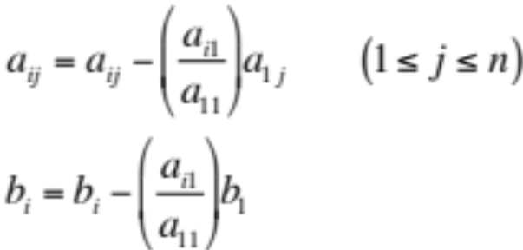
Gaussian Elimination
Forward elimination phase: n-1 steps.
First step is to use the first equation to produce n-1 zeros as coefficients for each x₁ in all but the first equation.
Done by subtracting the appropriate multiples of the first equation from the others.
First equation is referred to as the first pivot equation and to a₁₁ as the first pivot element.
For each of the remaining equations (2≤i≤n),we compute
Section 5.7
Matrices

Slide 18
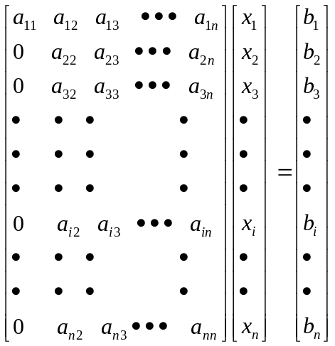
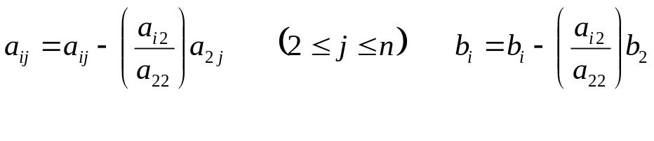
Gaussian Elimination
After this step, the system will be of the form
although the actual numerical values will no longer be the
original ones.
Repeat the process for second row and second column for the remaining equations (3≤i≤n)
For each of the remaining equations (3≤i≤n),we compute
Section 5.7
Matrices

Slide 19
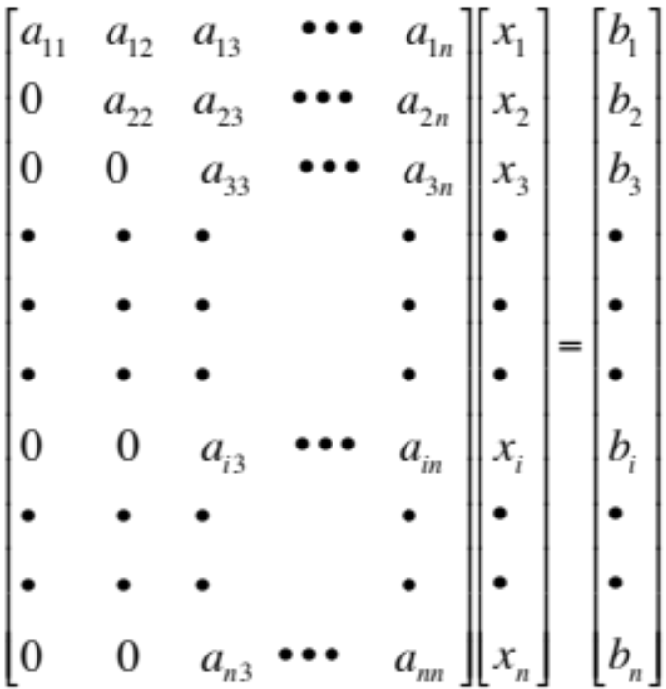
Gaussian Elimination
After this step, the system will be of the form
Repeat the process for the remaining rows (i.e., a total of n-1 times)
Section 5.7
Matrices

Slide 20
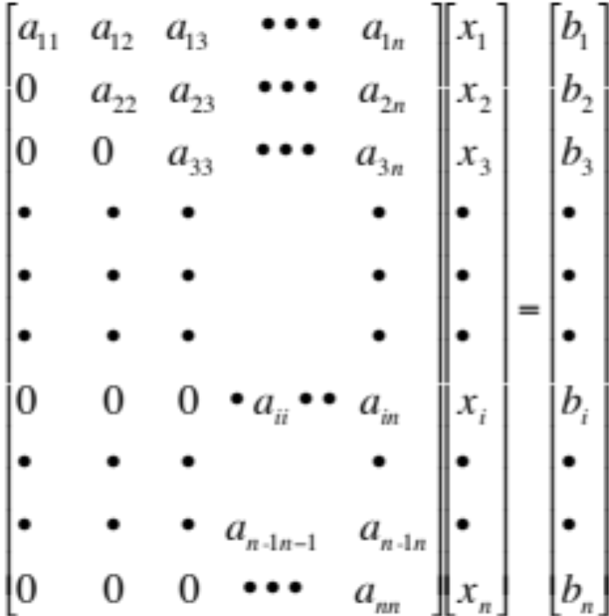
Gaussian Elimination
After this step, the system will be of lower triangular form where the lower triangle is all zeros.
This entire process is called forward elimination.
Section 5.7
Matrices

Slide 21
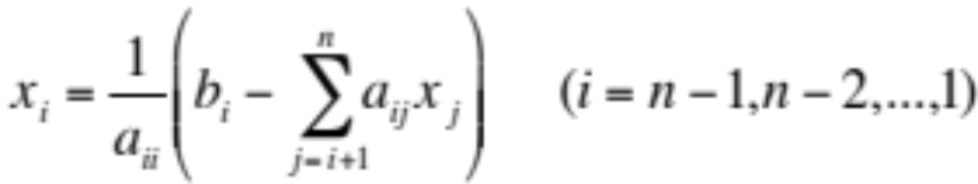
Gaussian Elimination (Back Substitution)
The back substitution starts from the last equation in the matrix to give a value for x_{n} which can be used to find the value of x_{n-1} and so on up to the value of x₁.
Sometimes, an augmented n × n+1 matrix is formed before doing the forward elimination process by adding the column of b's to the matrix of coefficients
The augmented matrix is simply a convenience to avoid having to write all the unknowns.
Section 5.7
Matrices

Slide 22
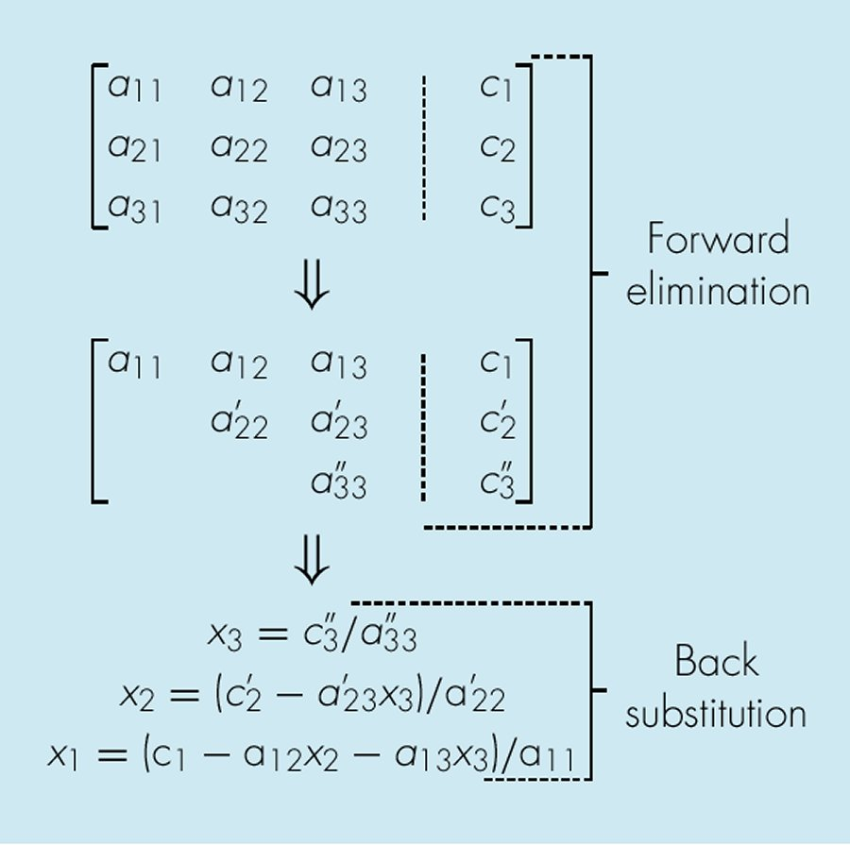
Gaussian Elimination- Example
The following is a simple example with a system of 3 linear equations
Section 5.7
Matrices

Slide 23
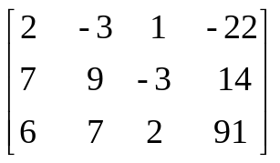
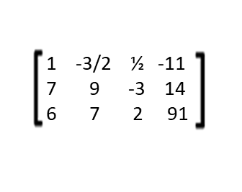
Gaussian Elimination Example
Apply Gaussian elimination to the system of 3 equations in 3 unknowns
2x – 3y + z = -22
7x + 9y – 3z = 14
6x + 7y + 2z = 91
The augmented matrix is
A series of elementary row operations will convert the 3 × 3 matrix of coefficients to upper triangular form.
  First, multiply row 1 by 1/2 to produce a 1 in the 1,1 position. This yields the following matrix:
Section 5.7
Matrices

Slide 24
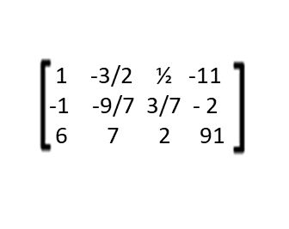
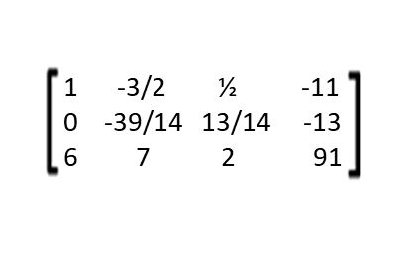
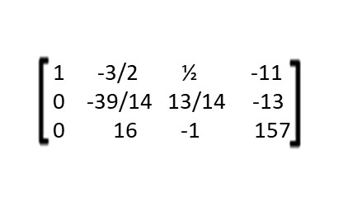
Gaussian Elimination Example
  Now Multiply Row 2 by -1/7 and use it as row 2 for now.
  Now set Row 2 equal to Row 2 + Row 1. This yields:
  Now multiply Row 1 x (-6) and it to Row 3. This will be your new Row 3:
Section 5.7
Matrices

Slide 25
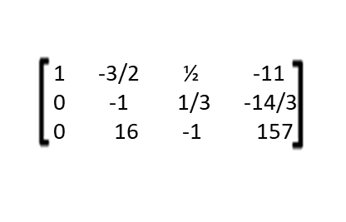
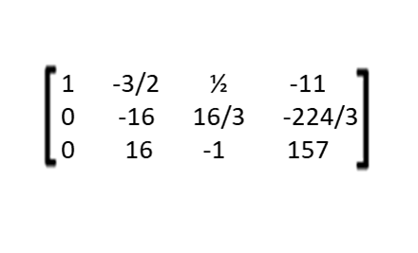
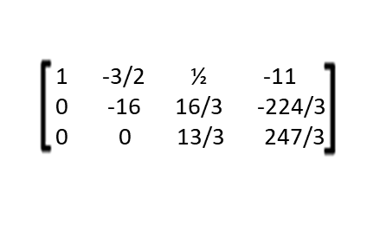
Gaussian Elimination Example
  Now multiply Row 2 x 14/39: this yields a new row 2 for the matrix:
  Now multiply Row 2 by 16, from this we have:
  Now set Row 3 = Row 2 + Row 3. This gives us the following matrix:
  Notice this gives us the matrix we are looking for. Row three has 1 unknown (Z) because the coefficients for X & Y are zero:
Section 5.7
Matrices

Slide 26
Gaussian Elimination Example
  Notice this gives us the matrix we are looking for. Row three has 1 unknown (Z) because the coefficients for X & Y are zero:
  Now writing down the equation from the last row of the matrix and proceeding with the back-substitution we have:
  0x + 0y + 13/3z = 247/3
  13/3 z = 247/3
  13 z = 247
  z = 19
Section 5.7
Matrices

Slide 27
Gaussian Elimination Example
  From Row 2 and z = 19 we have the following equation allowing us to solve for y:
  0x - 16y + 16/3z = -224/3
  -16y + 16/3 * 19 = -224/3
  -16y + 304/3 = -224/3
  -16y = -528/3
  -16y = -176
  y = 11
Section 5.7
Matrices

Slide 28
Gaussian Elimination Example
  From Row 3 and with z = 19 and y = 11 we can solve for y:
  x – 3/2y + ½z = -11
  x – 3/2(11) + ½(19) = -11
  x – 14/2 = 11
  x – 7 = 11
  x = 4
  You can check these answers for x=1, y=11 & z19 by substituting back into the original equations.
  The question is why would we do this?....we would not but computers can do this more efficiently and quickly with higher complexity (more simultaneous equations!)
Section 5.7
Matrices

Slide 29
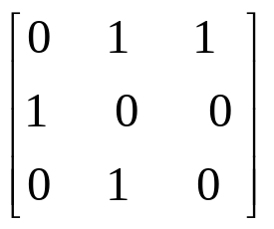
Boolean Matrices
Boolean matrices are matrices with only 0s and 1s as entries
Boolean matrix multiplication A × B on Boolean matrices uses Boolean multiplication and Boolean addition instead of regular multiplication and addition.
  Boolean multiplication: x ∧ y = min(x, y)
  Boolean addition: x ∨ y = max(x, y)
Section 5.7
Matrices

Slide 30
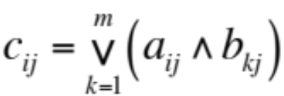
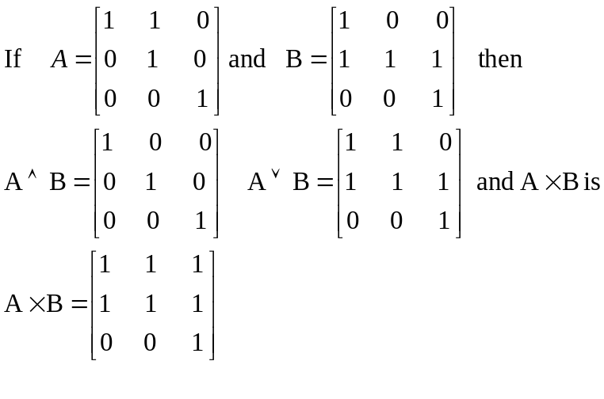
Boolean Matrices
The operation of Boolean matrix multiplication A × B (on Boolean matrices of appropriate dimensions) is then defined by
Example
Section 5.7
Matrices

